Slide 1

WEARSPER · TECH TALK
From Images to Intelligence:
Engineering a Multimodal AI Wardrobe System
Lessons from the messy middle between pilot and production
Teslim Bello
Founder & engineer, Wearsper
Notes:
[0:00–0:30] Hi, I'm Teslim. I built Wearsper on a minimal budget, an AI wardrobe system that turns photos of your clothes into structured data, then uses multimodal AI to recommend outfits made only from what you actually own. Tonight's lens is the messy middle between a pilot and production: integration, deployment, governance, monitoring, security and cost, through one real system. The vision pipeline, the reasoning layer, how I validate model output, and what broke in production. Two live demos along the way, then Q&A.

Slide 2
THE HOOK
What should I wear to a dinner date tonight?
Try a navy blazer over a white oxford, tan chinos and brown loafers.
Great advice.
You own none of it.
Swap "wardrobe" for product catalogue, policy library or CRM. It's the same enterprise failure: fluent, confident, ungrounded.
Notes:
[0:30–1:30] Ask any chatbot what to wear and you get a beautiful answer. Navy blazer, white oxford, tan chinos. The problem: it's describing someone else's wardrobe. The model has never seen your closet. Now swap 'wardrobe' for your product catalogue, your policy library, your CRM. It's the exact failure every enterprise copilot pilot hits: fluent, confident, and not grounded in your data. A wardrobe is just a small, very visual version of that problem. (Ask the room: how many of you own a navy blazer AND tan chinos? That's the hit rate.)

Slide 3



Three gaps every grounded AI system has to close
THE PROBLEM
Pixels aren't data
LLMs don't know your closet
Output must be wearable
Phone photos come with bad light, cluttered floors, folds and other clothes in frame. A model can't reason over a JPEG of a messy bed.
Language models are great stylists in general and know nothing about you. Without grounding they recommend items you don't own.
Two pairs of shoes, a dress over trousers, a parka in July. Plausible-sounding answers can still be impossible to wear.
Notes:
[1:30–2:45] Three gaps. One: pixels aren't data. Real photos are dim, cluttered, folded. Two: the language model doesn't know your closet, so it invents items. Three: even with real items, the answer has to be physically wearable and fit today's weather. Any system that only solves one of these feels broken to the user.

Slide 4
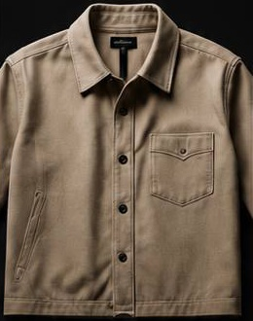







Four inputs, one grounded decision
THE INSIGHT · MULTIMODAL BY DESIGN
Visual input
Garment photos, cleaned and read by YOLOS, RemBG and CLIP
Text out
Two outfits as item ids + a short explanation, validated in code
Structured attributes
type · colour · style · formality, one row per item
Gemini 3.6 Flash
Reasons over attributes, request and weather. JSON mode, ids only.
Natural-language request
"Dinner date tonight, something smart"
Image out
Garment images + a faceless mannequin become a try-on photo
Live context
Pixels become rows first. Gemini never reasons over raw photos.
"6°C and rainy" from the phone's weather lookup
Notes:
[2:45–4:00] This is what multimodal means here, and the core design decision. Four inputs meet in one decision. Visual: the garment photos. Structured: the attributes the vision models extract from them, type, colour, style, formality. Language: what the person actually asked for. Context: live weather from the phone. The key move is that pixels become rows before the language model sees anything, so Gemini reasons over records, the request and the weather, and must answer with item ids. That makes the output checkable. Then the output goes multimodal again: the chosen garment images plus a faceless mannequin become a try-on photo.

Slide 5




One API, one source of truth, models behind it
INTEGRATION
Mobile app
FastAPI backend
Supabase
Expo / React Native. Uploads photos, sends requests plus live weather, polls jobs.
Railway. Verifies Supabase JWTs, queries with the user's own token so RLS applies, runs slow work in the background.
Postgres with Row Level Security on user tables. Storage for originals and processed PNGs.
Vision models (background task)
Gemini (reasoning + image)
YOLOS-Fashionpedia · RemBG isnet-general-use · CLIP ViT-B/32. Loaded once per process, cached.
3.6 Flash for outfits, gaps and tips, JSON mode. Image model for try-on, photoshoots, enhancement.
Notes:
[4:00–5:15] The app talks to one FastAPI service. Supabase is the single source of truth: Postgres for wardrobe items, recommendation jobs and plans, Storage for images. Two AI families sit behind the API: open-source vision models I host myself, and Gemini for reasoning and image generation. Key rule: classification never blocks the upload. The upload returns immediately; the pipeline runs as a background task and flips classification_status from processing to done or failed.

Slide 6
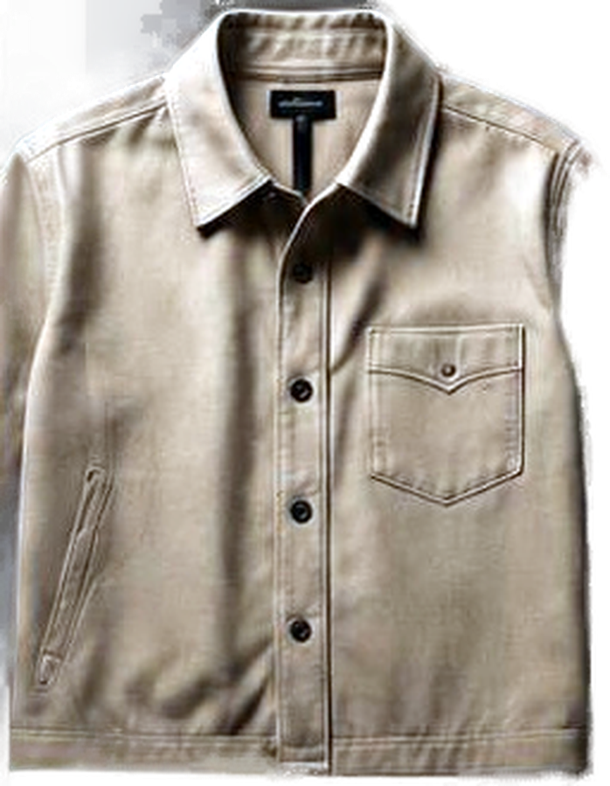
Six steps from a phone photo to a clean, labelled item
COMPUTER-VISION PIPELINE
1
Detect
2
Expose
3
Segment
4
Standardise
5
Describe
6
Save
YOLOS-Fashionpedia: garment type + box, 46 categories
Auto-levels only when mean brightness < 100
Downscale to 1600px, RemBG with alpha matting
Centre on a 1200px canvas, soft drop shadow
CLIP zero-shot: colour, style, formality
PNG to Storage, attributes to the row
CLIP says
colour beige
style minimalist
formality smart casual
Real output from the production code, run on a sample photo while preparing this talk.
Notes:
[5:15–6:30] Six steps, all in classification.py. Detect with YOLOS-Fashionpedia. Fix exposure, but only for genuinely dim photos; doing it to every photo made garments look harsh. Segment with RemBG, downscaled to 1600px first because alpha matting cost scales with pixel count, often 4 to 8 times fewer pixels. Standardise onto a 1200px canvas with a shadow so every item looks like a product shot. Then CLIP zero-shot for colour, style and formality: no training data needed. The strip at the bottom is the real code running on a real sample this week.

Slide 7
Every detector threshold came from a real failure
DEPLOYMENT LESSONS
12%
A shoe was labelled "belt" and a top "tie": a small detail outscored the dominant garment. Detections must now cover 12% of the photo.
0.50
Below it the item is honestly "unknown" and lands in Unsorted for the user to confirm, rather than sitting silently in the wrong category.
minimum share of the frame
minimum detection confidence
0.55
Fashionpedia learned from street-style photos and misreads solo watches. CLIP gets a second opinion on accessories only.
1
Two concurrent uploads hit Numba's non-thread-safe layer and killed the worker. One lock serialises just that call.
CLIP accessory override
lock around matting
Notes:
[6:30–7:45] None of these numbers came from a paper. Each came from a bug. Picking the single highest score meant a strap or fold could beat the whole garment, so a shoe became a belt. Now a detection must cover 12% of the frame. Below 0.5 confidence I'd rather say unknown than be confidently wrong. Fashionpedia's training data is street style, so it struggles with a watch on a table; CLIP, trained on far broader data, gets a vote on accessories. And a fatal native crash under concurrency taught me to lock exactly one call, not the whole pipeline. Note: 12%, 0.5 and 0.55 are starting values, still being tuned against a benchmark.

Slide 8
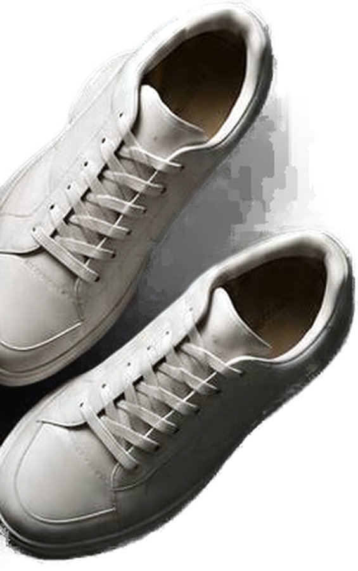
Photo in, structured item out
LIVE DEMO 1
Upload a garment photo from the phone
Watch classification_status: processing → done
Open the item: cutout, type, colour, style, formality
Backup if the network fails: this week's run on three sample photos
Overshirt
unknown
only parts found: sleeve 0.97, pocket 0.96
Sneakers
top, t-shirt 0.64
wrong type; colour beige correct
Real segmentation output, background removed
Bomber
belt 0.60
CLIP override fired on "unknown"; black-on-black cutout lost the jacket
Notes:
[7:45–9:45] DEMO. Upload a photo in the app, show the item appear as processing, then done, open it and read out the attributes. If the demo fails, use the table: I ran the real pipeline on three sample flat-lay photos this week. Be honest about it: the overshirt correctly came back 'unknown' because Fashionpedia only found parts; the sneakers were called a top; and the bomber became a 'belt' because the CLIP accessory check overrode an 'unknown' result. That last one is a real bug I found preparing this talk. These samples are low-res product renders, not typical phone photos, but the failure modes are real.

Slide 9

The prompt is a contract, not a conversation
AI REASONING ARCHITECTURE
WHAT GEMINI RECEIVES
WHAT IT MUST RETURN
The request
{"outfits": [
{"item_ids": ["a1f…", "7be…"],
"explanation": "…"},
{…}
]}
"Dinner date tonight, something smart"
Live weather
"6°C and rainy" from the phone, optional
The wardrobe as JSON
Only classified items: id, type, colour, style, formality
The rules
response_mime_type = application/json, so there's no prose to scrape
Exactly two outfits, 2–5 items each, ids as given. If variety is short, say so; never invent.
Notes:
[9:45–11:00] Recommendation is Gemini 3.6 Flash in JSON mode. The input is a contract: the user's words, optional live weather from the phone, and the wardrobe serialised as JSON with ids. Only items whose classification finished are included. The rules say exactly two outfits, two to five items, use ids exactly as given, and if the wardrobe lacks variety, say so instead of inventing. Deliberately not a custom-trained recommender: start with a general tool, earn the right to build bespoke.

Slide 10





Nothing reaches a user until it passes four gates
GOVERNANCE & VALIDATION
Parse
Strict JSON, or the attempt fails
Ground
Drop any id that isn't in this user's wardrobe
Plus a human in the loop
"unknown" sends an item to Unsorted, never a guessed category
Manual mode keeps the AI's guess as a hint until the user confirms
Gemini 503s retried twice, 3s apart, before the user sees an error
Structure
Max 1 bottom, 1 pair of shoes, 1 dress; no dress with trousers
Explain
If nothing survives, log why: model vs. our filters
Notes:
[11:00–12:15] This is my governance layer, and it lives in code, not in the prompt. Generation is cheap; validation is the product. Gate one: it must parse as JSON. Gate two, grounding: any id not in this user's wardrobe is dropped, so even a hallucinated id can't reach the screen. Gate three, structure: coarse slot rules catch three pairs of shoes or a dress with trousers. Colour harmony stays with the model. Gate four: if nothing survives, the log says whether Gemini returned nothing or my filters removed it, because 'it came back empty' isn't debuggable. And around the models, a human: unknown means Unsorted, and manual mode keeps the AI's guess as a hint.

Slide 11
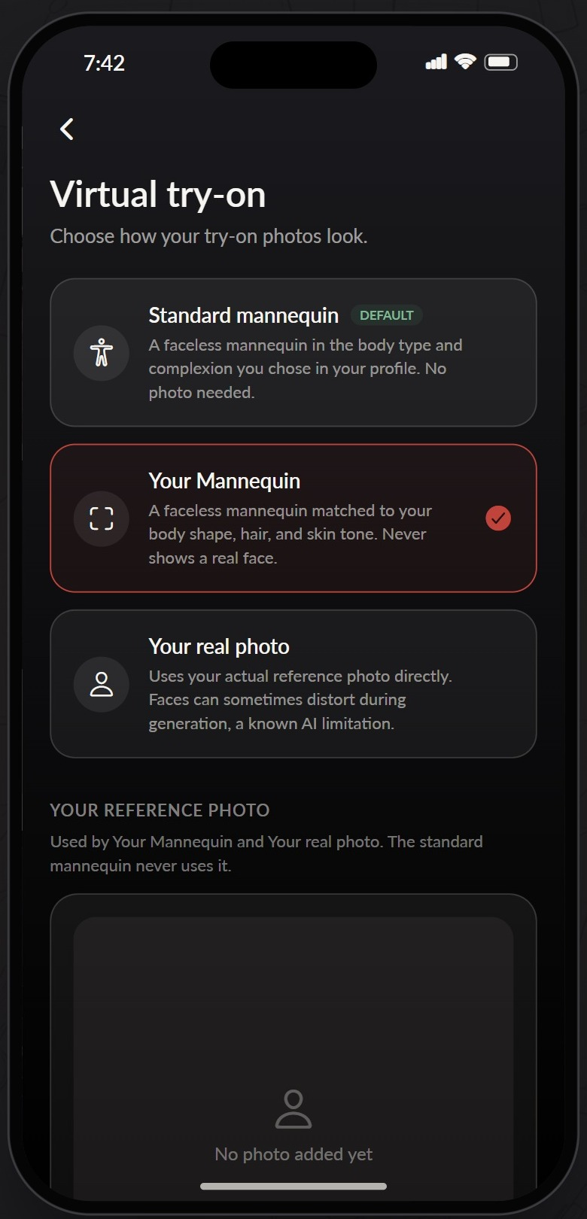
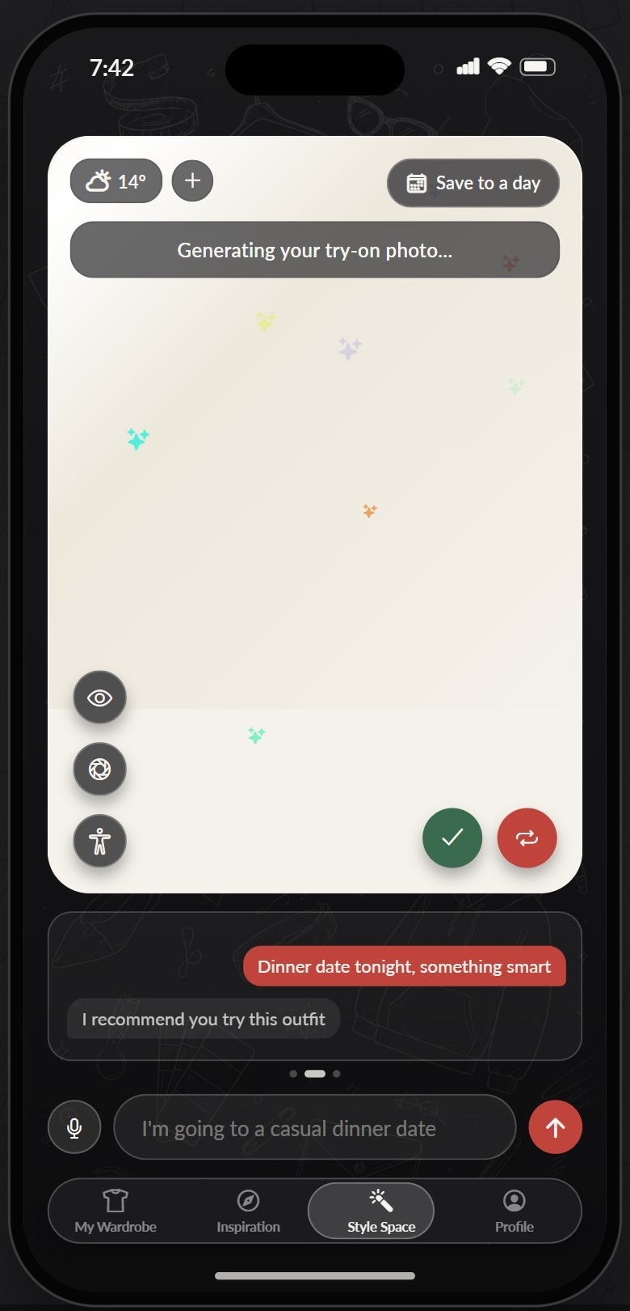
Remove what the model sees, don't ask it to ignore it
SECURITY & PRIVACY · LIVE DEMO 2
What failed
Prompts saying "preserve the face", then "don't use the real face". Identity still drifted, and with a clear face in the input the model kept using it.
What worked
A faceless mannequin as the base, matched to body shape and skin tone. Any face in the reference photo is blurred with OpenCV before upload.
Demo:
Type a request, get two grounded outfits
Pick Your Mannequin, tap try-on
Job returns 202; the app polls
Notes:
[12:15–14:15] DEMO 2. In Style Space, type a request, show the two outfits and point out every piece is from the wardrobe uploaded earlier. Then try-on. The lesson: early versions edited the user's real photo and told the model to preserve the face. Faces still drifted, a general limitation of generative editing. Then I told it not to use the face, and with a clear face visible it kept using it anyway. The fix wasn't a better prompt: take the face out of the input. Faceless mannequin base, proportions matched to the person, and any detected face blurred before upload. Users choose standard mannequin, Your Mannequin, or real photo with an explicit warning.

Slide 12






The messy middle: six things a pilot never tests
PILOT → PRODUCTION
Integration
Deployment
Governance
Gemini behind a strict JSON contract. Stripe and RevenueCat webhooks made idempotent with processed-event tables.
14–33 s model calls moved to a 202 + job-polling pattern. Models load once per process; the cache is set atomically.
Ids grounded against the user's data, structural rules in code, "unknown" over guesses, a human confirms.
Monitoring
Security
ROI
Per-stage timing logs: download, detect, segment, attributes, upload. Progress bars off after 6,000+ dropped lines.
JWTs verified on every route, Row Level Security on user tables, faces blurred before images leave, 15–30/hour limits.
Every paid call is explicit, metered and capped. Try-ons per tier: 5, 25, 60 a month. More on the next slide.
Notes:
[14:15–15:15] Mapping it back to tonight's themes. Integration: the model sits behind a JSON contract like any other service, and payment webhooks are idempotent so a retried event never double-applies. Deployment: Gemini took 14 to 33 seconds in my logs, so recommendations became async jobs that survive the app being backgrounded; models load once and a half-loaded cache can't stick. Governance: the gates you just saw, plus a human. Monitoring: timing logs per stage, and a lesson in log hygiene after Railway dropped over 6,000 messages. Security: JWT checks everywhere, Row Level Security in Postgres, faces blurred before any image goes to a third-party model, rate limits on the expensive routes. ROI: anything that costs money per call is explicit and metered, which brings me to the budget.

Slide 13
Production AI without an enterprise budget
ROI · BUILT ON A SHOESTRING
INSTEAD OF
I USED
1
Paid vision APIs
YOLOS, RemBG and CLIP, open source, loaded once inside the API server
A message queue (Redis, Celery)
A Postgres jobs table + FastAPI background tasks
pay-per-call AI service in the whole stack
A custom-trained recommender
Zero-shot CLIP + Gemini Flash behind a strict prompt
A paid weather API
Open-Meteo, no key needed
Gemini, only where reasoning or image generation is worth paying for. Everything else is open source or free to call.
AI polish on every upload
Free cleanup always; paid polish only when the user asks
Open-ended spend
Monthly caps per tier and hourly rate limits
Notes:
[15:15–16:15] I want to be honest about how this was built: on a minimal budget, without access to the advanced paid services most teams reach for. That constraint shaped every decision. There's exactly one pay-per-call AI service in the stack, Gemini, and only where reasoning or image generation is worth paying for. Vision is open-source models running inside the API server. There's no message queue; a Postgres table plus FastAPI background tasks does the job. No custom model training; zero-shot CLIP and a strict prompt. The free cleanup runs on every upload, the paid polish only when someone asks, and every paid feature is capped. The point for enterprise teams: these constraints produce the architecture you'd want anyway, few paid dependencies and every cost explicit. Budget isn't what stands between a pilot and production; discipline is. (Optional: if you're comfortable, quote your real monthly running cost here.)

Slide 14
TAKEAWAYS FOR YOUR NEXT PILOT
01
Separate perception from reasoning
Turn unstructured inputs into records first; let the LLM reason only over what it can cite.
02
Govern in code, not in prompts
Questions?
Ground ids, enforce structure, log why outputs were dropped. Prompts ask; code decides.
03
Make uncertainty a product feature
Teslim Bello
wearsper.com
An honest "unknown" routed to a human beats a confident error in production.
The model is the easy part. The messy middle is the product, and it doesn't need a big budget.
Notes:
[16:15–17:00, then Q&A] Three things to take into your next pilot. Separate perception from reasoning: get unstructured inputs into records before the LLM touches them. Govern in code, not in prompts: prompts ask, code decides. And make uncertainty a feature: route 'unknown' to a human instead of shipping a confident error. The model is the easy part; the messy middle is the product, and it doesn't need a big budget. Thank you. Likely questions: why not fine-tune (cost and data; zero-shot first, earn the right to customise); accuracy (benchmark in progress, say so honestly); data residency and third-party model risk (faces blurred before upload, mannequin by default); cost per user (metered tiers, opt-in paid steps).

